Slide 1
Applied Data Science Capstone Capstone Project - The Battle of Neighbourhoods (Week 2)
PURPOSE
This document provides the details of my final peer reviewed assignment for the IBM Data Science Professional Certificate program – Coursera Capstone.

Slide 2
Problem statement
Singapore is City state located in busiest shipping lanes in the world; it’s a small island nation with a thriving tourism industry.
The internet provides host of information to visit and stay in and around Singapore. However, most of the recommendations are simply based on usual tourist attractions or residential areas that are mostly expensive or already known for travellers based on certain keywords like "Hotel", or "Backpackers" etc.
The intention on this project is to collect and provide a data driven recommendation that can supplement the recommendation with statistical data. This will also be utilizing data retrieved from Singapore open data sources and FourSquare API venue recommendations.

Slide 3
Data Sources
Singapore Towns and median residential rental prices
Data will retrieved from Singapore open dataset from median rent by town and flattype from https://data.gov.sg website.
Singapore Towns location data retrieved using Google maps API
Singapore Top Venue Recommendations from FourSquare API

Slide 4
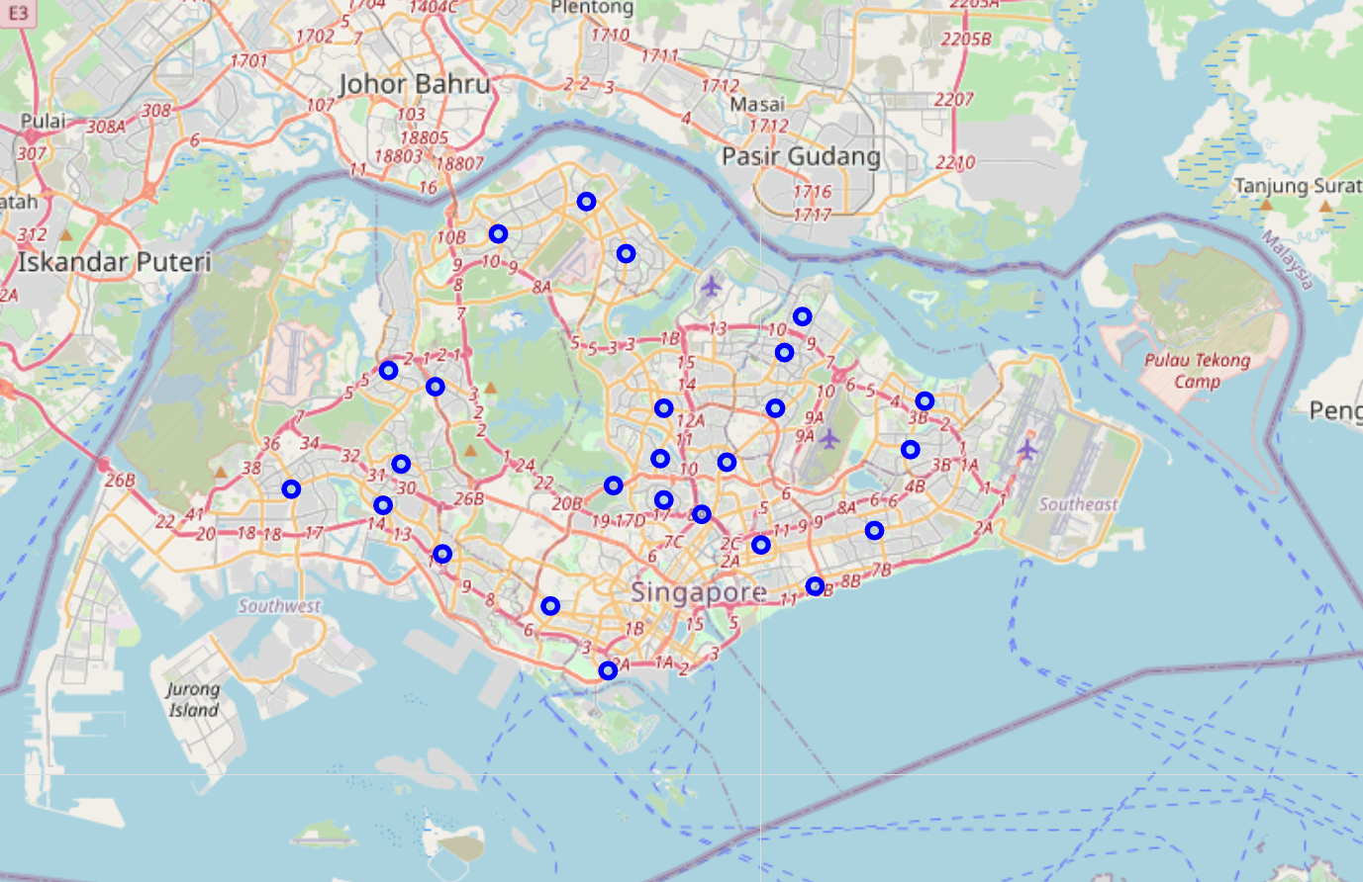
Various Towns in Singapore

Slide 5
Conclusion
The central region of Island, has most attractions for both locals and visitors alike due to various food options and night life
The conclusion is supported by data analysed

Slide 6
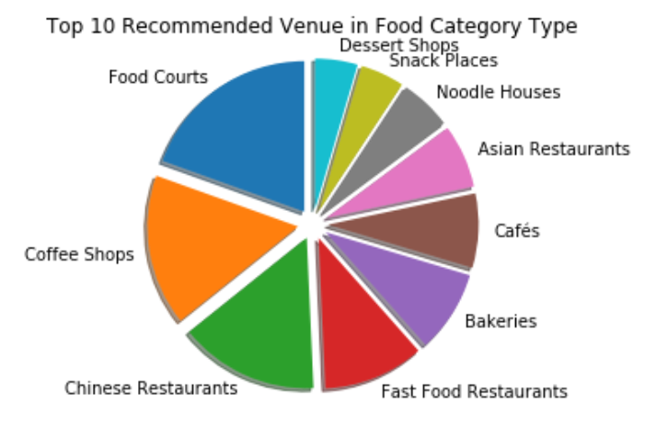
Top 10 Food Category type

Slide 7
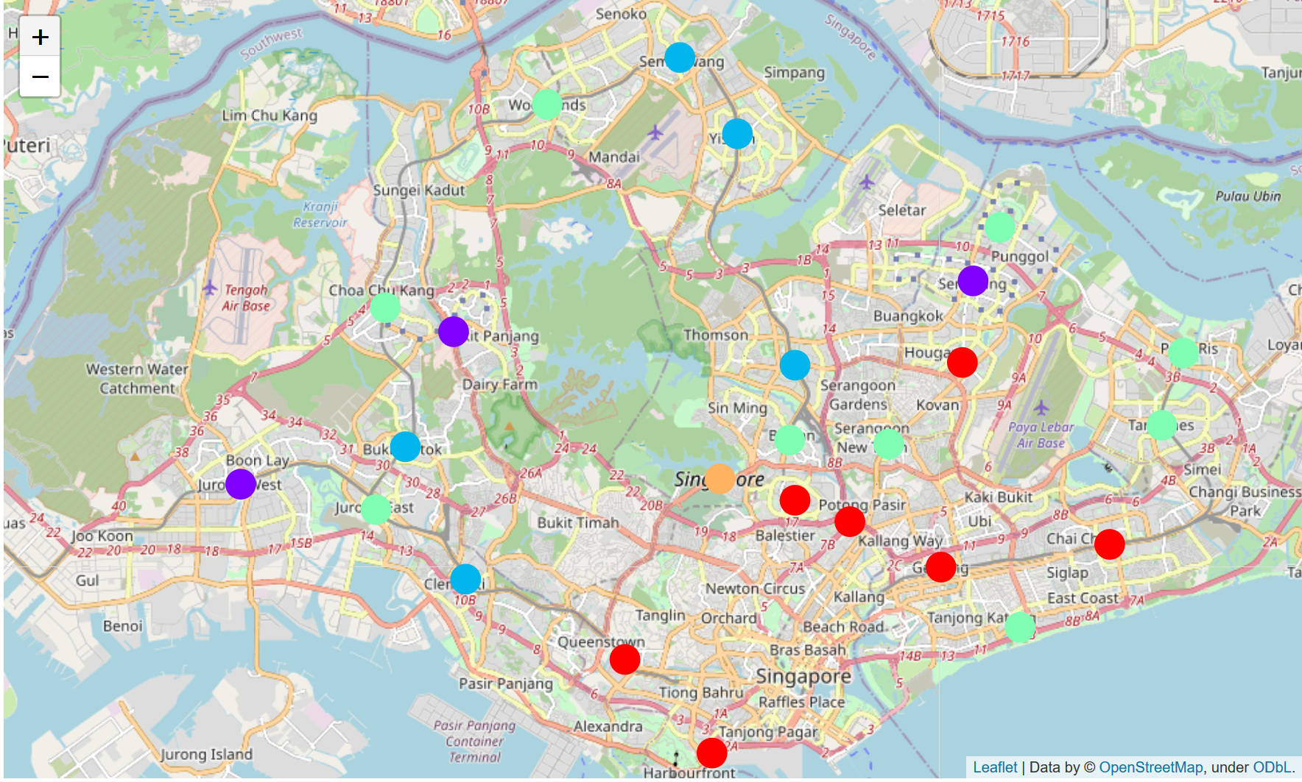
Clusters generated based on the dataset

